Slide 1
Microservices and DevOps
DevOps and Container Technology
NoSQL
Henrik Bærbak Christensen

Slide 2
Motivation
Relational Databases has ruled the ‘persistent storage’ universe for decades
XML and Object-oriented databases were hot – and fizzled out…
Why did NoSQL databases then succeed?
RDB’s did not scale well for massive, web, data
Unstructured and evolving data
Massive amounts of data required scaling fast
Consistency makes RDB’s slow and increase likelihood of failures
Adopted by Google, Twitter, Facebook…
BigTable (Google) began around 2004

Slide 3
Key features
NoSQL: ”Not Only SQL” / Not Relational
Horizontal scaling of simple operations over many servers
Replication and partitioning data over many servers
Simple call level interface (contrast: SQL)
Weaker concurrency model than ACID
Efficient use of RAM and dist. indexes for storage
Ability to dynamically add new attributes to records
Architectural Drivers:
Performance
Scalabilty
[Cattel, 2010]

Slide 4
Clarifications
NoSQL focus on
Simple operations
Key lookup, read/write of one or a few records
Opposite: Complex joins over many tables (SQL)
NoSQL joins are handled client side !!!
Why is the argument for that?
Horizontal scaling
Many servers with no RAM nor disk sharing
Any server may serve a read request => balances load
Commodity hardware
Cheap but more prone to failures
Notes:
Client side joins means the CPU load is shifted towards the clients doing the work, opposed to the server doing it. If one server serves 100.000 clients – then it offloads a lot of work from the server.

Slide 5
NoSQL DB Types

Slide 6
Basic types
Four types
Key-value stores
Memcache, Riak, Redis, …
Document stores
MongoDB, …
Extensible record (Hu: Column)
Cassandra, Google BigTable
Graph stores
Neo4J

Slide 7
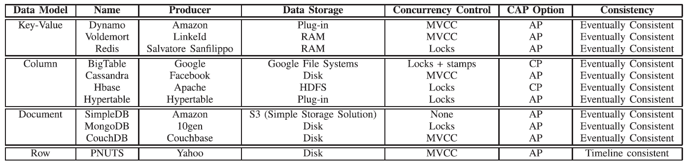
Overview by Hu

Slide 8
Key-value
Basically the Java Map<KeyType, ValueType> datastructure:
Map.put(”pid01-2012-12-03-11-45”, measurement);
m = Map.get(”pid01-2012-12-03-11-45”);
Schema: Any value under any key…
Supports:
Automatic replication
Automatic sharding
Both using hashing on the key
Only lookup using the (primary) key
Often memory based, with periodic flushing to disk.
Thus RAM may become a bottleneck!

Slide 9
MVCC
Multi-Version Concurrency Control
To avoid reading an item while others are updating it
To avoid classic concurrency ‘locking’
Data update
No overwrite but…
Mark old version as obsolete
Add new version with timestamp of entry
Periodic sweep to erase obsolete data
Point in time consistent read view
Read with a timestamp

Slide 10
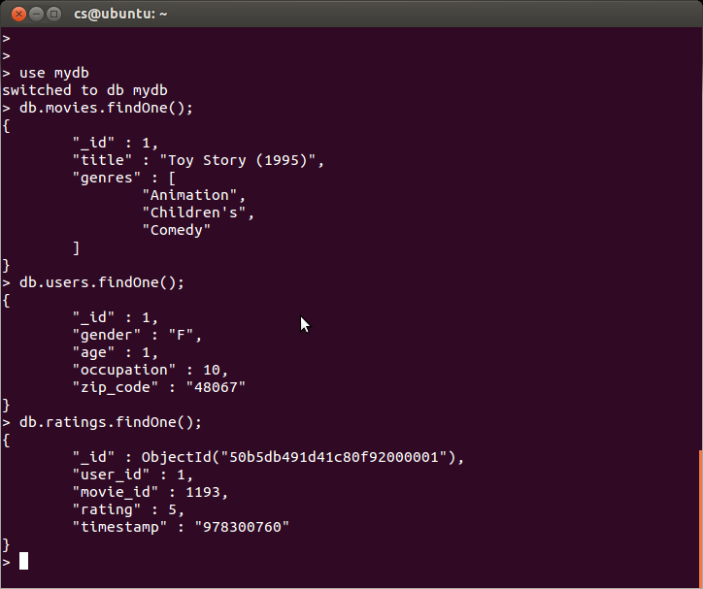
Document
Stores ”documents”
MongoDB: JSON objects.
Stronger queries, also in document contents
Schema: Any JSON object may be stored!
Atomic updates, otherwise no concurrency control
Supports
Master-slave replication, automatic failover and recovery
Automatic sharding
Range-based, on shard key (like zip-code, CPR, etc.)

Slide 11
Extensible Record/Column
First kid on the block: Google BigTable
Datamodel
Table of rows and columns
Scalability model: splitting both on rows and columns
Row: (Range) Sharding on primary key
Column: Column groups – domain defined clustering
No Schema on the columns, change as you go
Generally memory-based with periodic flushes to disk

Slide 12
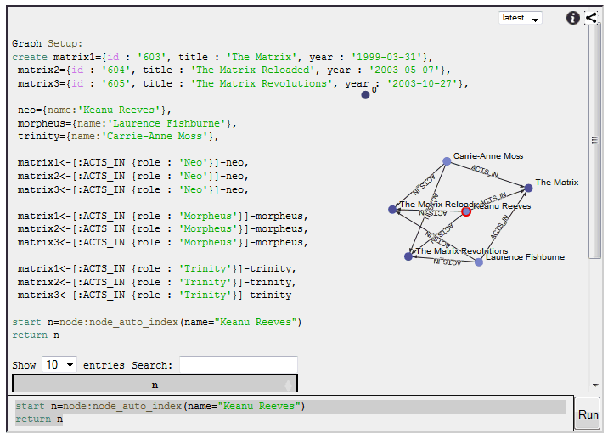
(Graph)
Neo4J

Slide 13
CAP Theorem

Slide 14
Reviewing ACID
Basic RDBM teaching talks on ACID
Atomicity
Transaction: All or none succeed
Consistency
DB is in valid state before and after transaction
Isolation
N transactions executed concurrently = N executed in sequence
Durability
Once a transaction has been committed, it will remain so (even in the event of power loss, crash)

Slide 15
CAP
Eric Brewer: only get two of the three in scaled system:
Consistency
Reads and writes see the same valid and consistent state
”Every read receives the most recent write or an error” [wikipedia]
Availability
Able to serve when it’s needed
”Every request receives a (non-error) response – without the guarantee that it contains the most recent write”
Partition tolerance
Operation will complete, even if components are unavailable
”The system continues to operate despite an arbitrary number of messages being dropped (or delayed) by the network between nodes”

Slide 16
Horizontal Scaling: P taken
We have already taken P, so we have to relax either
Consistency
Availability
RDBM prefer consistency over availability
NoSQL prefer availability over consistency
replacing it with eventual consistency

Slide 17
Achieving ACID
Two-phase Commit
All partitions pre-commit, report result to master
If success, master tells each to commit; else roll-back
Guaranty consistency, but availability suffer
Example
Two partitions, 99.9% availability
=> 99.9² = 99.8% (+43 min down every month)
Five partitions:
99,5% (36 hours down time in all)

Slide 18
BASE
Replace ACID with BASE
BA: Basically available
S: Soft state
E: Eventual consistent
Availability achieved by partial failures not leading to system failures
In two-phase commit, what would master do if one partition does not respond?

Slide 19
Eventual Consistency
So what does this mean?
Upon write, an immediate read may retrieve the old value – or not see the newest added item!
Why? Gets data from a replica that is not yet updated…
Eventual consistency:
Given sufficiently long period of time which no updates, all replicas are consistent, and thus all reads consistently return the same data…
System always available, but state is ‘soft’ / cached

Slide 20
Discussion
Web applications
Is it a problem that a facebook update takes some minutes to appear at my friends?
As Newman points out [p. 236]
Consistency is a ‘computerish’ thing, usually the real world is pretty full of issues that invalidate consistency anyway
While picking the The Brakes album from inventory of 100 records, the staff knocks on album on the floor and accidentally breaks it. Computer says 99 copies left, inventory contains 98. Who is right?
And real world counterparts have correcting mechanisms
Sorry, we cannot deliver at the promised date…

Slide 21
Summary
NoSQL – born to address real issues arriving from modern web applications
Horizontal scaling on commodity hardware
Sacrifices Consistency for Availability
CAP theorem states that this is the trade-off
Solution: BASE rather than ACID
Or rather ‘eventual consistency’
Types
Key-value, documents, column
Schema less – or rather dynamic schemas

